Slide 1
Transactions I
Instructor: Dr. Sonam Nahar

Slide 2
Transactions
Transaction Concept
Transaction State
Concurrent Executions
Serializability
Recoverability
Implementation of Isolation
Transaction Definition in SQL
Testing for Serializability.

Slide 3
Introduction
A collection of several operations on the database appears to be a single unit from the point of view of the database user.
For example, a transfer of funds from a checking account to a savings account is a single operation from the customer’s view; within the database system, however, it consists of several operations.
Collections of operations that form a single logical unit of work are called transactions.
A database system must ensure:
  proper execution of transactions despite failures - either the entire transaction executes, or none of it does.
  manage concurrent execution of transactions in a way that avoids inconsistency.
In our funds-transfer example, a transaction computing the customer’s total money might see the checking-account balance before it is debited by the funds transfer transaction, but see the savings balance after it is credited. As a result, it would obtain an incorrect result.

Slide 4
Transaction Concept
A transaction is a unit of program execution that accesses and possibly updates various data items.
A transaction must see a consistent database.
During transaction execution the database may be temporarily inconsistent.
When the transaction completes successfully (is committed), the database must be consistent.
After a transaction commits, the changes it has made to the database persist, even if there are system failures.
Multiple transactions can execute in parallel.
Two main issues to deal with:
  Failures of various kinds, such as hardware failures and system crashes
  Concurrent execution of multiple transactions

Slide 5
ACID Properties
A transaction is a unit of program execution that accesses and possibly updates various data items. To preserve the integrity of data the database system must ensure:
Atomicity. Either all operations of the transaction are properly reflected in the database or none are.
Consistency. Execution of a transaction in isolation preserves the consistency of the database.
Isolation. Although multiple transactions may execute concurrently, each transaction must be unaware of other concurrently executing transactions. Intermediate transaction results must be hidden from other concurrently executed transactions.
  That is, for every pair of transactions T_{i} and T_{j}, it appears to T_{i} that either T_{j}, finished execution before T_{i} started, or T_{j} started execution after T_{i} finished.
Durability. After a transaction completes successfully, the changes it has made to the database persist, even if there are system failures.

Slide 6
Example of Fund Transfer
Consider a simplified banking system consisting of several accounts and a set of transactions that access and update those accounts.
Transactions access data using two operations:
  read(X), which transfers the data item X from the database to a local buffer belonging to the transaction that executed the read operation.
  write(X), which transfers the data item X from the local buffer of the transaction that executed the write back to the database.
Transaction to transfer $50 from account A to account B:
  1. read(A)
  2. A := A – 50
  3. write(A)
  4. read(B)
  5. B := B + 50
  6. write(B)

Slide 7
Example of Fund Transfer (Cont.)
Consistency requirement
  the sum of A and B is unchanged by the execution of the transaction.
  Ensuring consistency for an individual transaction is the responsibility of the application programmer who codes the transaction.
Atomicity requirement
  if the transaction fails after write(A) and before write(B), the system should ensure that its updates are not reflected in the database, else an inconsistency will result.
  Examples of failures include power failures, hardware failures, and software errors.
  Ensuring atomicity is the responsibility of the database system itself; specifically, it is handled by a component called the transaction-management component

Slide 8
Example of Fund Transfer (Cont.)
Durability requirement
  once the user has been notified that the transaction has completed (i.e., the transfer of the $50 has taken place), the updates to the database by the transaction must persist despite failures.
  One can guarantee durability by ensuring that either:
    The updates carried out by the transaction have been written to disk before the transaction completes
    Information about the updates carried out by the transaction and written to disk is sufficient to enable the database to reconstruct the updates when the database system is restarted after the failure.
  Ensuring durability is the responsibility of a component of the database system called the recovery-management component.

Slide 9
Example of Fund Transfer (Cont.)
Isolation requirement
  if several transactions are executed concurrently, their operations may interleave in some undesirable way, resulting in an inconsistent state.
  if between steps write(A) and write(B), another transaction is allowed to access the partially updated database, it will see an inconsistent database (the sum A + B will be less than it should be).
  Isolation can be ensured trivially by running transactions serially, that is one after the other.
  However, executing multiple transactions concurrently has significant benefits, as we will see later.
  Ensuring the isolation property is the responsibility of a component of the database system called the concurrency-control component,

Slide 10
Transaction State
A transaction is called aborted when it does not complete its execution successfully.
To ensure atomicity, any changes that the aborted transaction made to the database must be undone.
Once the changes caused by an aborted transaction have been undone, the transaction has been rolled back.
A transaction that completes its execution successfully is said to be committed.
A committed transaction that has performed updates transforms the database into a new consistent state, which must persist even if there is a system failure.
Once a transaction has committed, we cannot undo its effects by aborting it.

Slide 11
Transaction State (Cont.)
A transaction must be in one of the following states:
  Active – the initial state; the transaction stays in this state while it is executing
  Partially committed – after the final statement has been executed.
  Failed -- after the discovery that normal execution can no longer proceed.
  Aborted – after the transaction has been rolled back and the database restored to its state prior to the start of the transaction. Two options after it has been aborted:
    restart the transaction; can be done only if no internal logical error
    kill the transaction
  Committed – after successful completion.

Slide 12

Transaction State (Cont.)

Slide 13
Implementation of Atomicity and Durability
The recovery-management component of a database system implements the support for atomicity and durability.
The shadow-database scheme:
  assume that only one transaction is active at a time.
  a pointer called db_pointer always points to the current consistent copy of the database.
  all updates are made on a shadow copy of the database, and db_pointer is made to point to the updated shadow copy only after the transaction reaches partial commit and all updated pages have been flushed to disk.
  in case transaction fails, old consistent copy pointed to by db_pointer can be used, and the shadow copy can be deleted.
  The transaction is said to have been committed at the point where the updated db_pointer is written to disk.
Deal with Transaction failure and System failure.

Slide 14

Implementation of Atomicity and Durability (Cont.)
The shadow-database scheme:
Assumes disks do not fail
Useful for text editors, but
  extremely inefficient for large databases
  Does not handle concurrent transactions

Slide 15
Concurrent Executions
Multiple transactions are allowed to run concurrently in the system. Advantages are:
  increased processor and disk utilization, The parallelism of the CPU and the I/O system can be exploited to run multiple transactions in parallel. This is leading to better transaction throughput i.e., number of transactions executed in a given amount of time: one transaction can be using the CPU while another is reading from or writing to the disk
  reduced average response time for transactions: short transactions need not wait behind long ones. If the transactions are operating on different parts of the database, it is better to let them run concurrently, sharing the CPU cycles and disk accesses among them. It also reduces the average response time: the average time for a transaction to be completed after it has been submitted.
Concurrency control schemes – mechanisms to achieve isolation; that is, to control the interaction among the concurrent transactions in order to prevent them from destroying the consistency of the database

Slide 16
Schedules
Schedule – a sequences of instructions that specify the chronological order in which instructions of concurrent transactions are executed
  a schedule for a set of transactions must consist of all instructions of those transactions
  must preserve the order in which the instructions appear in each individual transaction.
A transaction that successfully completes its execution will have a commit instructions as the last statement (will be omitted if it is obvious)
A transaction that fails to successfully complete its execution will have an abort instructions as the last statement (will be omitted if it is obvious)
A serial schedule consists of a sequence of instructions from various transactions, where the instructions belonging to one single transaction appear together in that schedule. Thus, for a set of n transactions, there exist n! different valid serial schedules.
For non-serial schedule, the CPU time is shared among all the transactions.

Slide 17

Schedule 1
Let T₁ transfer $50 from A to B, and T₂ transfer 10% of the balance from A to B.
A serial schedule in which T₁ is followed by T₂:
Suppose the current values of accounts A and B are $1000 and $2000, respectively.
The sum A+B is preserved after the execution of both transactions.

Slide 18

Schedule 2
A serial schedule where T₂ is followed by T₁

Slide 19

Schedule 3
Let T₁ and T₂ be the transactions defined previously. The following schedule is not a serial schedule, but it is equivalent to Schedule 1.
In Schedules 1, 2 and 3, the sum A + B is preserved.

Slide 20

Schedule 4
The following concurrent schedule does not preserve the value of (A + B) i.e., database goes into inconsistent state.

Slide 21
Schedules
If control of concurrent execution is left entirely to the operating system, many possible schedules, including ones that leave the database in an inconsistent state, are possible.
The concurrency-control component of the database system ensure that any schedule that gets executed will leave the database in a consistent state.
We can ensure consistency of the database under concurrent execution by making sure that any schedule that executed has the same effect as a schedule that could have occurred without any concurrent execution. That is, the schedule should, in some sense, be equivalent to a serial schedule

Slide 22
Serializability
Basic Assumption – Each schedule preserves database consistency.
Thus serial execution of a set of transactions preserves database consistency.
A (possibly concurrent) schedule is serializable if it is equivalent to a serial schedule. Different forms of schedule equivalence give rise to the notions of:
  1. conflict serializability
  2. view serializability
We ignore operations other than read and write instructions, and we assume that transactions may perform arbitrary computations on data in local buffers in between reads and writes. Our simplified schedules consist of only read and write instructions.

Slide 23
Conflicting Instructions
Consider a schedule S in which there are two consecutive instructions I_{i} and I_{j}, of transactions T_{i} and T_{j}, respectively (i is not equals to j).
If I_{i} and I_{j} refer to different data items, then we can swap I_{i} and I_{j} without affecting the results of any instruction in the schedule.
If I_{i} and I_{j} refer to the same data item Q, then the order of the two steps may matter
Instructions l_{i} and l_{j} of transactions T_{i} and T_{j} respectively, conflict if and only if there exists some item Q accessed by both l_{i} and l_{j}, and at least one of these instructions wrote Q.
  l_{i} = read(Q), l_{j} = read(Q). l_{i} and l_{j} don’t conflict.
  l_{i} = read(Q), l_{j} = write(Q). They conflict.
  l_{i} = write(Q), l_{j} = read(Q). They conflict
  l_{i} = write(Q), l_{j} = write(Q). They conflict

Slide 24
Conflicting Instructions
Intuitively, a conflict between l_{i} and l_{j} forces a (logical) temporal order between them.
  If l_{i} and l_{j} are consecutive in a schedule and they do not conflict, their results would remain the same even if they had been interchanged in the schedule.

Slide 25
Conflict Serializability
If a schedule S can be transformed into a schedule S´ by a series of swaps of non-conflicting instructions, we say that S and S´ are conflict equivalent.
We say that a schedule S is conflict serializable if it is conflict equivalent to a serial schedule
Example: Schedule 3 can be transformed into Schedule 5, a serial schedule where T₂ follows T₁, by series of swaps of non-conflicting instructions as follows:
  Swap the read(B) instruction of T1 with the write(A) instruction of T2.
  Swap the read(B) instruction of T1 with the read(A) instruction of T2.
  • Swap the write(B) instruction of T1 with the write(A) instruction of T2.
  • Swap the write(B) instruction of T1 with the read(A) instruction of T2.

Slide 26


Conflict Serializability (Cont.)
  Therefore Schedule 3 is conflict serializable.
Schedule 3
Schedule 5

Slide 27

Conflict Serializability (Cont.)
Example of a schedule that is not conflict serializable:
We are unable to swap instructions in the above schedule to obtain either the serial schedule < T₃, T₄ >, or the serial schedule < T₄, T₃ >.
It is possible to have two schedules that produce the same outcome, but that are not conflict equivalent.

Slide 28
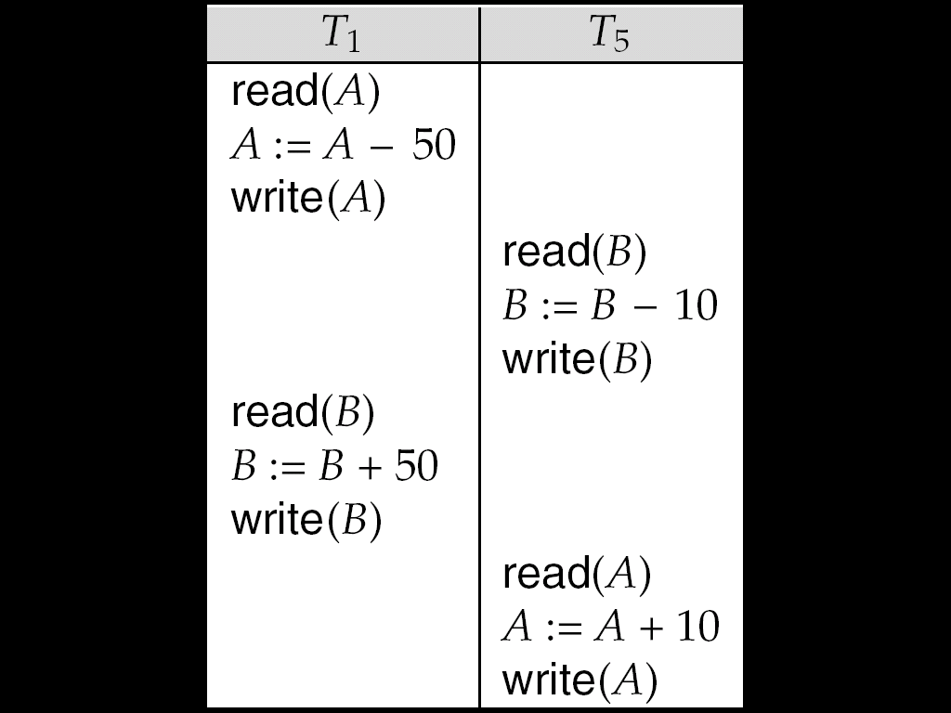
Conflict Serializability (Cont.)
The schedule below produces same outcome as the serial schedule < T₁, T₅ >, yet is not conflict equivalent.
Determining such equivalence requires analysis of operations other than read and write.

Slide 29
View Serializability
Let S and S´ be two schedules with the same set of transactions. S and S´ are view equivalent if the following three conditions are met:
  1. For each data item Q, if transaction T_{i} reads the initial value of Q in schedule S, then transaction T_{i} must, in schedule S´, also read the initial value of Q.
  2. For each data item Q if transaction T_{i} executes read(Q) in schedule S, and that value was produced by transaction T_{j} (if any), then transaction T_{i} must in schedule S´ also read the value of Q that was produced by transaction T_{j} .
  3. For each data item Q, the transaction (if any) that performs the final write(Q) operation in schedule S must perform the final write(Q) operation in schedule S´.
As can be seen, view equivalence is also based purely on reads and writes alone.

Slide 30

View Serializability (Cont.)
A schedule S is view serializable it is view equivalent to a serial schedule.
Every conflict serializable schedule is also view serializable.
Below is a schedule which is view-serializable but not conflict serializable.
What serial schedule is above equivalent to?
Every view serializable schedule that is not conflict serializable has blind writes.

Slide 31
Recoverability
Need to address the effect of transaction failures on concurrently
running transactions.
It it is necessary to ensure that any transaction T_{j} that is dependent on T_{i} (i.e., T_{j} has read data written by T_{i}) is also aborted.
We address the issue of what schedules are acceptable from the viewpoint of recovery from transaction failure.

Slide 32
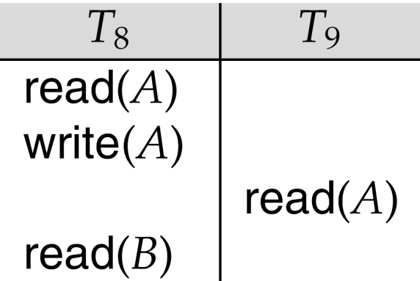
Recoverable Schedules
The following schedule is not recoverable if T₉ commits immediately after the read
If T₈ should abort, T₉ would have read (and possibly shown to the user) an inconsistent database state. Hence, database must ensure that schedules are recoverable.
Recoverable schedule — if a transaction T_{j} reads a data item previously written by a transaction T_{i} , then the commit operation of T_{i} appears before the commit operation of T_{j}.

Slide 33

Cascading Rollbacks
Cascading rollback – a single transaction failure leads to a series of transaction rollbacks. Consider the following schedule where none of the transactions has yet committed (so the schedule is recoverable)
If T₁₀ fails, T₁₁ and T₁₂ must also be rolled back.
Can lead to the undoing of a significant amount of work

Slide 34
Cascadeless Schedules
Cascadeless schedules — cascading rollbacks cannot occur; for each pair of transactions T_{i} and T_{j} such that T_{j} reads a data item previously written by T_{i}, the commit operation of T_{i} appears before the read operation of T_{j}.
Every cascadeless schedule is also recoverable
It is desirable to restrict the schedules to those that are cascadeless

Slide 35
Implementation of Isolation
Schedules must be conflict or view serializable, and recoverable, for the sake of database consistency, and preferably cascadeless.
A policy in which only one transaction can execute at a time generates serial schedules, but provides a poor degree of concurrency.
Concurrency-control schemes tradeoff between the amount of concurrency they allow and the amount of overhead that they incur.
Some schemes allow only conflict-serializable schedules to be generated, while others allow view-serializable schedules that are not conflict-serializable.

Slide 36
Testing for Serializability
Consider some schedule of a set of transactions T₁, T₂, ..., T_{n}
Precedence graph — a direct graph where the vertices are the transactions (names).
We draw an arc from T_{i} to T_{j} if the two transaction conflict, and T_{i} accessed the data item on which the conflict arose earlier.
We may label the arc by the item that was accessed.
In other words, the set of edges consists of all edges T_{i} →T_{j} for which one of three conditions holds:
  1. T_{i} executes write(Q) before T_{j} executes read(Q).
  2. T_{i} executes read(Q) before T_{j} executes write(Q).
  3. T_{i} executes write(Q) before T_{j} executes write(Q).

Slide 37

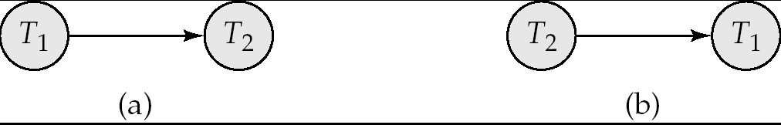
Testing for Serializability
If an edge T_{i} → T_{j} exists in the precedence graph, then, in any serial schedule S’ equivalent to S, T_{i} must appear before T_{j} .
Example 1: precedence graph for schedule 3
Example 2: precedence graph for schedule 1 and 2

Slide 38

Test for Conflict Serializability
A schedule is conflict serializable if and only if its precedence graph is acyclic.
Cycle-detection algorithms exist which take order n² time, where n is the number of vertices in the graph.
  (Better algorithms take order n + e where e is the number of edges.)
If precedence graph is acyclic, the serializability order can be obtained by a topological sorting of the graph.
  This is a linear order consistent with the partial order of the graph.
  For example, a serializability order for Schedule A would be
  T₅ → T₁ → T₃ → T₂ → T₄
    Are there others?

Slide 39
Example Schedule (Schedule A) + Precedence Graph
T₁ T₂ T₃ T₄ T₅
read(X)
read(Y)
read(Z)
read(V)
read(W)
read(W)
read(Y)
write(Y)
write(Z)
read(U)
read(Y)
write(Y)
read(Z)
write(Z)
read(U)
write(U)
T₁
T₂
T₄
T₃
T₅

Slide 40
Test for View Serializability
The precedence graph test for conflict serializability cannot be used directly to test for view serializability.
  Extension to test for view serializability has cost exponential in the size of the precedence graph.
The problem of checking if a schedule is view serializable falls in the class of NP-complete problems.
  Thus existence of an efficient algorithm is extremely unlikely.
However practical algorithms that just check some sufficient conditions for view serializability can still be used.

Slide 41
Concurrency Control
A database must provide a mechanism that will ensure that all possible schedules are
  either conflict or view serializable, and
  are recoverable and preferably cascadeless
A policy in which only one transaction can execute at a time generates serial schedules, but provides a poor degree of concurrency
  Are serial schedules recoverable/cascadeless?
Testing a schedule for serializability after it has executed is a little too late!
Goal – to develop concurrency control protocols that will assure serializability.

Slide 42
Concurrency Control vs. Serializability Tests
Concurrency-control protocols allow concurrent schedules, but ensure that the schedules are conflict/view serializable, and are recoverable and cascadeless.
Concurrency control protocols generally do not examine the precedence graph as it is being created
  Instead a protocol imposes a discipline that avoids nonseralizable schedules.
  We study such protocols in Chapter 16.
Different concurrency control protocols provide different tradeoffs between the amount of concurrency they allow and the amount of overhead that they incur.
Tests for serializability help us understand why a concurrency control protocol is correct.

Slide 43
Levels of Consistency in SQL-92
Serializable — default
Repeatable read — only committed records to be read, repeated reads of same record must return same value. However, a transaction may not be serializable – it may find some records inserted by a transaction but not find others.
Read committed — only committed records can be read, but successive reads of record may return different (but committed) values.
Read uncommitted — even uncommitted records may be read.
Lower degrees of consistency useful for gathering approximate
information about the database

Slide 44
Transaction Definition in SQL
Data manipulation language must include a construct for specifying the set of actions that comprise a transaction.
In SQL, a transaction begins implicitly.
A transaction in SQL ends by:
  Commit work commits current transaction and begins a new one.
  Rollback work causes current transaction to abort.
Levels of consistency specified by SQL-92:
  Serializable — default
  Repeatable read
  Read committed
  Read uncommitted

